Slide 1
Hacking the High Seas: China's Cyber Shenanigans at the Seattle-Tacoma Maritime Ports
Binisha Kanjaria, Dominic Mathew, Habib N'Garnim, and Vanshika Srivastava

Slide 2
Executive Summary
PURPOSE
FOCUS
Aims to analyze the cyber threats posed by nation-states, focusing on China's potential cyber threats against the Seattle-Tacoma Maritime Ports in the United States.
To understand the offensive capabilities of China and United States with the increasing prevalence of cyber warfare and espionage, and developing effective defense strategies.
RECOMMENDATIONS
KEY FINDINGS
Enhance cybersecurity measures through:
Improved Segmentation
Secure File Transfer
Advanced Threat Detection
Tighter Access Control
Chinese APTs constitute 31% of global APTs and are increasing attacks on critical infrastructure in the United States. Volt Typhoon is a well-known APT that is targeting critical infrastructure globally.

Slide 3
Project Scope and Timeline
SCOPE | Analysis of China’s Cyber strength and USA’s Seattle-Tacoma Maritime Port vulnerabilities.
OBJECTIVES | Analysis of China's cyber operations and tactics, focusing on potential threats to the Seattle-Tacoma Port, and identify vulnerabilities in the port's cybersecurity for strategic defense measures.
TIMELINE | Research and threat assessment: Weeks 1-6 Strategy development: Weeks 6-8 Presentation preparation: Weeks 8-10
LIMITATIONS | Reliance on available data for analysis, potential resource constraints affecting the depth of analysis, and the possibility of incomplete coverage of all cyber threats faced by the Seattle-Tacoma Ports.

Slide 4
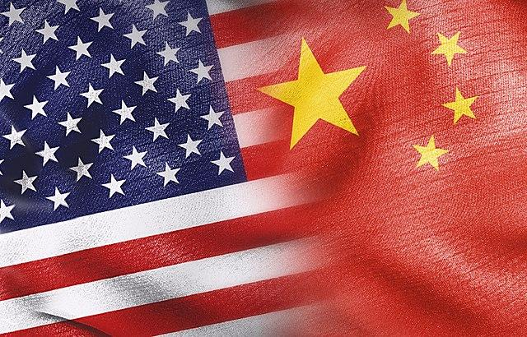
Introduction to Nation-States
China: A Cyber Superpower: China stands out as a leading cyber superpower, with sophisticated cyber capabilities and a history of engaging in state-sponsored cyber activities.
1
2
The United States: A Cyber Fortress: As a global technological powerhouse, the United States possesses robust cyber defenses but is also a prime target for cyber adversaries due to its critical infrastructure and advanced technology sectors.
Understanding the Cyber Battlefield: By examining the cyber activities of these two nation-states, we aim to gain insights into their tactics, motivations, and potential impacts on global cybersecurity.
3
Significance of the Analysis: In an increasingly digitized world where cyber threats pose significant risks to national security and economic stability, understanding the strategies employed by nation-states is crucial for developing effective defense mechanisms and safeguarding against cyber attacks.
4

Slide 5


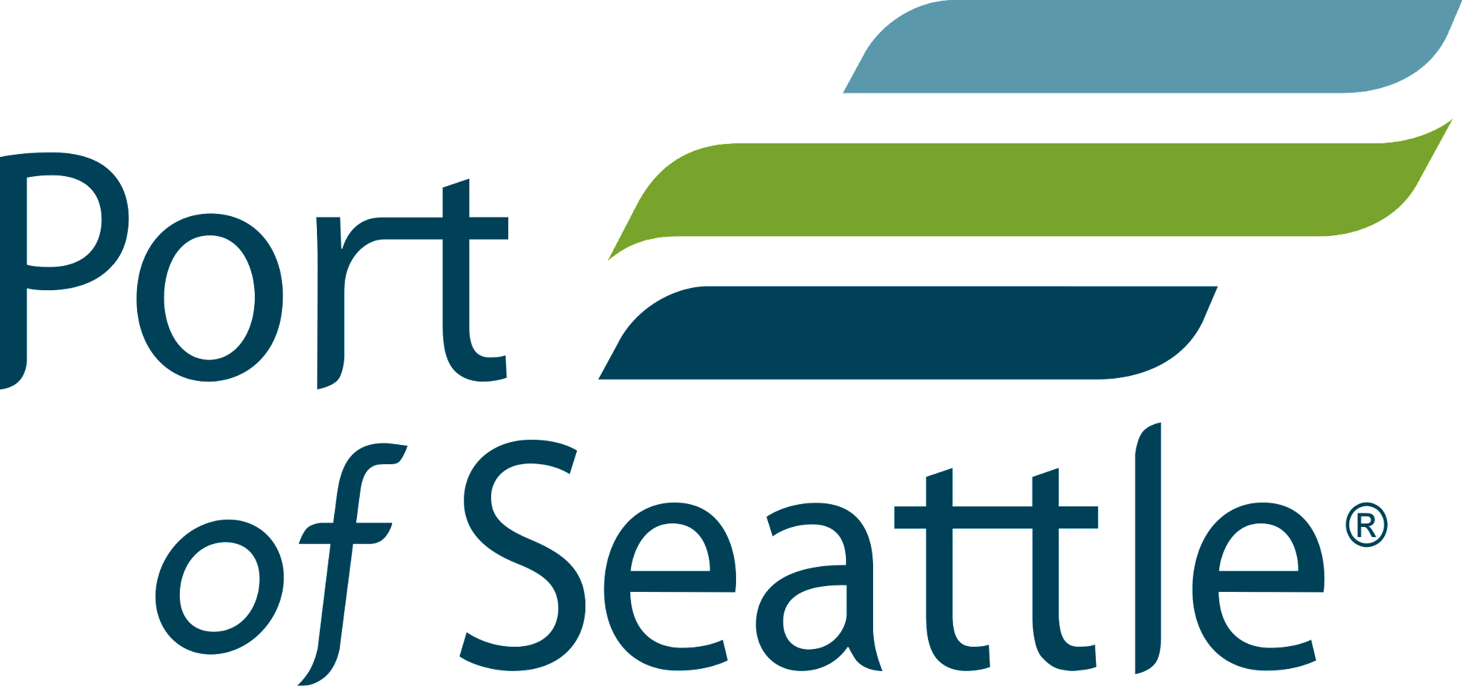
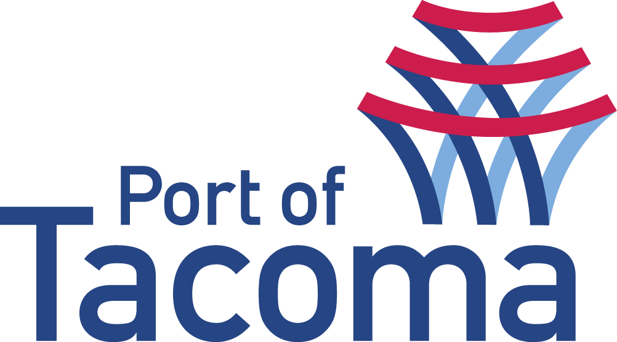


Asset Analysis: Seattle-Tacoma Port
Why Sea-Tac Port?
Significance in Global Trade
The combined Seattle-Tacoma Port is the 4th largest port in the United States, and is a critical node in international trade and commerce
The Seattle-Tacoma Port, situated strategically on the West Coast, is a crucial hub for imports and exports, managing significant cargo traffic
Economic Impact
Interconnectedness with Supply Chains
The port is a vital economic driver, generating $12.4 billions in revenue and supporting more than 58,000 jobs in shipping, logistics, and manufacturing industries
The port's integration into global supply chains facilitates trade between the US and Asia-Pacific markets. Disruptions could cause ripple effects across industries and economies
Notes:
Northwest Seaport Alliance (NWSA): In 2015, the ports of Seattle and Tacoma formed the NWSA, a marine cargo operating partnership aimed at consolidating management functions like planning, operations, and marketing. The NWSA oversees the marine cargo terminal operations of both ports, allowing them to coordinate efforts and compete more effectively on a global scale.
While Seattle and Tacoma maintain their respective terminals and facilities, they have developed interoperable systems and processes. The NWSA manages the marine cargo terminals and related infrastructure, which involves shared technology platforms and operational standards.
https://www.nwseaportalliance.com/about-us/cargo-statistics

Slide 6
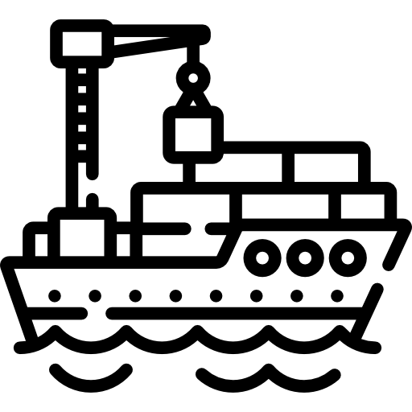

Past Phishing Incident at the Port of Seattle
 | Phishing incidents at the Port of Seattle in 2021 resulted in the loss of over $570,000 in public funds. Two reported phishing incidents led to eight payments to fraudulent bank accounts. Recovery efforts saw $522,683 recovered through direct recovery and insurance. Audit findings highlighted inconsistent adherence to procedures and ineffective employee training. Response included mandatory cyber fraud training and annual refresher courses, aiming to improve staff awareness and vigilance.
Notes:
In 2021, the Port of Seattle lost over $570,000 in phishing scams, with two incidents resulting in $572,683 in fraudulent payments. Recovery efforts, including direct retrieval and insurance, were partly successful. Audit findings revealed inconsistent adherence to security protocols and inadequate employee training. As a response, mandatory cyber fraud training was initiated, with annual refresher courses introduced in 2022. This incident reflects broader cybersecurity challenges in Washington state, with over $28 million lost to cyber fraud since 2016. Common phishing indicators include generic greetings, billing alerts, payment detail requests, language errors, free offers, and solicitation of personal information. https://www.king5.com/article/news/local/seattle/port-of-seattle-loses-money-to-phishing-scams/281-4efd3b7a-8dec-4b83-8f77-e0c5ea85d5fd

Slide 7

Nation-State Analysis
Attacking nation: China & Defending nation: U.S.A

Slide 8
The United States: Maritime Assets
EXTENSIVE COASTLINE | 95,000+ miles, with 25,000 miles of waterways for intermodal connections. Gateway to 95% of global trade.
HIGH TECHNOLOGY ADOPTION | U.S. ports use advanced technologies including automated gate handling, Port Community System platform for data sharing, digital twins, IoT devices and AI-ML on terminal OS.
LARGE PORT NETWORK | 360 ports support 30 million jobs and generate activities equivalent to 26% of the United States’ GDP.
PORT OF SEATTLE-TACOMA | Under the Northwest Seaport Alliance, the combined ports, share tech and ops, and are the 4th largest in the country, and mostly handles trans-Pacific trade.
Notes:
*GAO report to Congressional Committee on Port Infrastructure U.S. Ports Have Adopted Some Automation Technologies and Report Varied Effects, 2024
*MTS-ISAC Cybersecurity 2023 Annual Impact Report, 2023

Slide 9
The United States: Vulnerabilities
INCREASING RELIANCE ON TECHNOLOGY | Dependence on internet-connected systems exposes ports to ransomware, espionage, and control system breaches. 2,400 cyberattacks in 2023 alone.
VARIED CYBER ATTACKS | Phishing remains the biggest threat. New malware variants, increased password spraying and aggressive zero-day vulnerability probes have seen a rise too.
DEPENDENCE ON FOREIGN MANUFACTURING | Majority of industrial machinery at ports designed-manufactured overseas by adversarial competitors. E.g. 80% of ship-to-shore cranes are made by one Chinese company, ZPMC.
MULTIPLE AGENCY COORDINATION | Cyber response is spread across CISA, U.S. Coast Guard, USTRANSCOM, FEMA, FBI and TSA. Responses can be piecemeal and not strategic.
Notes:
*https://www.hklaw.com/en/insights/publications/2024/03/white-house-us-coast-guard-seek-to-address-maritime

Slide 10
China: APT Landscape
01
02
03
04
INCREASED APT ACTIVITY
GEOGRAPHIC DIVERSITY
STATE LED & SPONSORED
APT FOCUS
Chinese APT groups have targeted 180 organizations across 33 countries in the last two years.
Most APT attacks were in the APAC region, but growing in the EU and North Americas.
Controlled by the Ministry of State Security, run in a ‘whole country’ approach leveraging different state assets.
31% (47/152) of global APTs are China sponsored and generally attack critical infrastructure and hard-software supply chains.
Notes:
*https://www.cpomagazine.com/cyber-security/chinese-apt-group-compromised-at-least-70-government-organizations-in-23-different-countries/
*analysis from https://attack.mitre.org/groups/
*https://en.wikipedia.org/wiki/Advanced_persistent_threat

Slide 11
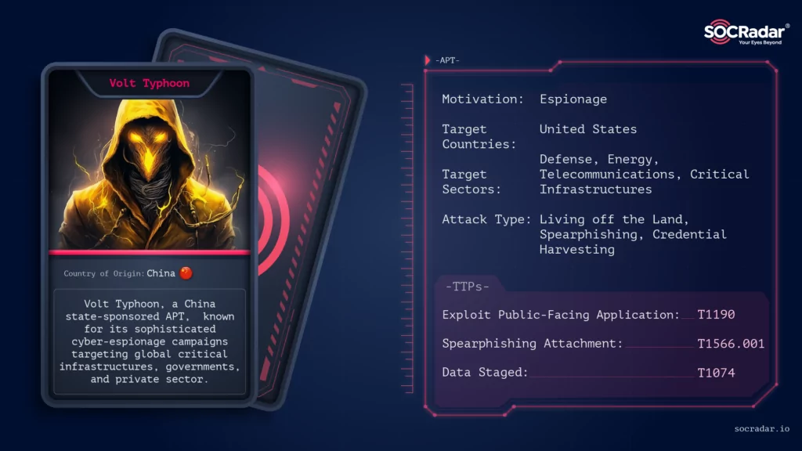
Volt Typhoon
Notes:
https://socradar.io/apt-profile-volt-typhoon/

Slide 12
Volt Typhoon
Based on the intelligence community’s assessments, Volt Typhoon is associated and sponsored by China due to the patterns in their TTPs and targets.
1
Historical focus on collecting and exfiltrating sensitive information by compromising internet-connected devices related to critical infrastructure systems of Western states.
2
The use of "living off the land" techniques shows a sophisticated attack backed by resources.
3
Techniques such as: targeting personal emails of key staff and exploiting vulnerabilities in small and end-of-life routers, firewalls, and VPNs, etc.
Notes:
This approach makes LOTL attacks difficult to detect, especially with traditional security tools that rely on known malware scripts or files.
These attacks do not require the installation of any malicious code or scripts within the target system. Instead, they leverage native tools that are already present in the environment, such as PowerShell, Windows Management Instrumentation (WMI), or the password-saving tool, Mimikatz.
The group has compromised thousands of devices, exploiting vulnerabilities such as weak administrator passwords, factory default logins, and devices that haven’t been updated regularly

Slide 13
HISTORICAL ATTACKS
May 2023
August 2021
Port in Houston attack which extended into: telecommunications companies, government agencies, power plants, and water treatment facilities.
Volt Typhoon continues to attack critical infrastructure: communications, manufacturing, utility, transportation, construction, maritime, government, information technology, and education. Microsoft security analysts identify these series of attacks based off the TTPs, particularly living-off-the-land techniques.
February 2024
Volt Typhoon’s botnet was disrupted by the US which led to the group changing methodology by re-exploiting already compromised devices such as Cisco and DrayTek routers and Axis IP cameras. From the original 1500 active bots there are now ~650.
Notes:
A year after the Houston attack, Guam’s two major telecoms faced cyberattacks which compromised key telecoms infrastructure.
The operation has compromised thousands of internet-connected devices
The operation is believed to be focused on espionage and information gathering, with a potential to disrupt critical communications infrastructure.
https://www.csoonline.com/article/1306501/china-backed-volt-typhoon-preparing-wave-of-attacks.html

Slide 14
SIGNATURE ATTACKS
ACCOUNT DISCOVERY
Exploit weak password policies or misconfigured user permissions using account enumeration methods like net ground commands.
PUBLIC-FACING APP VULNERABILITY
Exploit unpatched software versions or web server misconfigurations, like CVE-2021-40539 in ManageEngine ADSelfService Plus servers for initial access to a system.
EXPLOIT COMMAND & SCRIPTING ERRORS
Leverage PowerShell or Windows Command Shell for remote system discovery.
COMPROMISE INFRASTRUCTURE
Target servers and network devices for Command & Control or as proxies. E.g. compromised PRTG servers, home devices used as proxies for network traffic.
CREDENTIAL THEFT
Obtain credentials from OpenSSH, realvnc, PuTTY or hashed creds from LSASS memory to escalate privileges.

Slide 15

Port of Seattle Vulnerabilities
Logistic Management Systems
Security Inspection Equipment
Logink, a widely used logistics management system developed by the PRC collects massive amounts of sensitive business and government vessel and cargo data
Nuctech, a PRC controlled company manufactures port security inspection equipment. This equipment grants access to confidential like biometric info, PII, proprietary data, geolocational metadata, and cargo pattern data
Port Equipment
Intelligence Reports
The US Gov’t has claimed that 80% of the ship-to-shore cranes moving trade at US Ports are made in China, creating vulnerabilities in IT and OT systems
The FBI has collected intelligence indicating that Volt Typhoon may be preparing for a extensive attack on American critical infrastructure which would “wreak havoc and cause real world harm”
Notes:
https://www.cnbc.com/2024/03/13/a-look-inside-the-true-nature-of-chinese-cyber-threat-at-us-ports.html
https://www.maritime.dot.gov/msci/2024-002-worldwide-foreign-adversarial-technological-physical-and-cyber-influence

Slide 16
The United State’s Security Response Posture
In February 2024, an executive order was signed in response to intelligence and maritime advisories signaling the exposed vulnerabilities of United States Ports. This executive order broadens the powers of the Department of Homeland Security
$
U.S. Coast Guard
Investment
Improved Posture
Foreign Intelligence Surveillance Act
Now has control over the movement of vessels and must establish minimum cybersecurity requirements at ports
$20 billion to be invested in port infrastructure and $100 million invested in port security
Dedicated remote access systems and processes for crane devices which utilize and enforce MFA
Recent legislation passed allows the government to collect communications of foreign individuals through tech and phone providers
Notes:
https://www.nytimes.com/2024/02/21/us/politics/cybersecurity-ports.html?searchResultPosition=2
https://techcrunch.com/2024/04/20/fisa-nsa-fbi-government-surveillance/?guccounter=1
https://www.fema.gov/grants/preparedness/port-security

Slide 17

CASE STUDY
A hypothetical attack on Seattle’s Port by Volt Typhoon

Slide 18

SEATTLE-TACOMA PORT VULNERABILITIES
WAYS TO EXPLOIT
VOLT TYPHOON SIGNATURE ATTACKS
DATA BREACH
DENIAL-OF-SERVICE (DOS)
SUPPLY CHAIN ATTACK
CREDENTIAL THEFT
SOFTWARE VULNERABILITY
COMPROMISED REMOTE ACCESS
FIRMWARE MANIPULATION
IOT DEVICE COMPROMISE
UNAUTHORIZED ACCESS (PHYSICAL/REMOTE)
DATA MANIPULATION
NETWORK-BASED ATTACKS
RANSOMWARE
INSIDER THREATS
LOGISTICS MANAGEMENT SYSTEM
ACCOUNT DISCOVERY
comprehensive software suite managing supply chain operations, including transportation, inventory, and distribution, across multiple entities.
PUBLIC-FACING APP VULNERABILITY
PORT EQUIPMENT
essential for cargo handling, including cranes, forklifts, container handlers, and automated systems. Connectivity modules track vessels, load weights and movement.
EXPLOIT COMMAND & SCRIPTING ERRORS
COMPROMISED INFRASTRUCTURE
TERMINAL OPERATING SYSTEM
specialized software facilitating efficient terminal operations within a port, including container handling, vessel scheduling, and yard management.
CREDENTIAL THEFT

Slide 19
Recommendations: What can the U.S. do to increase its Security Posture?
Secure File Transfer
Advanced Threat Detection
Tighter Access Control
Improved Segmentation
Improve segmentation between the crane and other port systems/networks/operating systems to reduce an adversary’s initial cyber access to domain control. Monitor all communications on the crane network
Improve access control with multi factor authentication for all systems. Combine with increased and frequent training on cybersecurity practices for all employees
Utilize secure file transfer tools/maintain a secure file transfer to reduce the risk of malware when transferring files into the crane network
Implement advanced threat detection tools, e.g. Microsoft 365 Defender to monitor activities like: LSASS process memory dumping and internal proxy set up which are both strategies Volt Typhoon uses.
Notes:
https://www.maritime.dot.gov/msci/2024-002-worldwide-foreign-adversarial-technological-physical-and-cyber-influence

Slide 20
Conclusion
 | In a scenario where China sponsors attacks on the US, they can utilize an APT like Volt Typhoon which specifically targets nation-states using living off the land techniques which consist of using existing system tools to launch cyber attacks while evading detection. Their operations are believed to be focused on espionage, information gathering, and disruption of communication.
 | In the case study, the APT can target key vulnerabilities such as: Logistics Management Systems, Port Equipment, and Terminal Operating Systems which are integrated across the Ports of Seattle and Tacoma.
 | To tighten up security, the US maritime authorities can invest further in: improving segmentation across operating systems, using more secure tools for file transfers, implementing better threat detection tools, and utilizing MFA and training employees.

Slide 21
References

Slide 22
References
https://www.king5.com/article/news/local/seattle/port-of-seattle-loses-money-to-phishing-scams/281-4efd3b7a-8dec-4b83-8f77-e0c5ea85d5fd
GAO report to Congressional Committee on Port Infrastructure U.S. Ports Have Adopted Some Automation Technologies and Report Varied Effects, 2024
MTS-ISAC Cyber Security 2023 Annual Impact Report, 2023
https://www.hklaw.com/en/insights/publications/2024/03/white-house-us-coast-guard-seek-to-address-maritime
https://www.cpomagazine.com/cyber-security/chinese-apt-group-compromised-at-least-70-government-organizations-in-23-different-countries/
Analysis based on data from https://attack.mitre.org/groups/
https://en.wikipedia.org/wiki/Advanced_persistent_threat
https://socradar.io/apt-profile-volt-typhoon/
https://www.cnbc.com/2024/03/13/a-look-inside-the-true-nature-of-chinese-cyber-threat-at-us-ports.html
https://www.maritime.dot.gov/msci/2024-002-worldwide-foreign-adversarial-technological-physical-and-cyber-influence
https://www.csoonline.com/article/1306501/china-backed-volt-typhoon-preparing-wave-of-attacks.html
https://www.nytimes.com/2024/02/21/us/politics/cybersecurity-ports.html?searchResultPosition=2
https://techcrunch.com/2024/04/20/fisa-nsa-fbi-government-surveillance/?guccounter=1
https://www.fema.gov/grants/preparedness/port-security
Mapped vulnerabilities to Volt Typhoon’s signature moves https://attack.mitre.org/groups/G1017/
https://www.maritime.dot.gov/msci/2024-002-worldwide-foreign-adversarial-technological-physical-and-cyber-influence
https://www.csoonline.com/article/1306501/china-backed-volt-typhoon-preparing-wave-of-attacks.html
https://www.microsoft.com/en-us/security/blog/2023/05/24/volt-typhoon-targets-us-critical-infrastructure-with-living-off-the-land-techniques/
https://www.justice.gov/opa/pr/us-government-disrupts-botnet-peoples-republic-china-used-conceal-hacking-critical
https://www.cisa.gov/news-events/cybersecurity-advisories/aa24-038a
https://techxplore.com/news/2024-04-volt-typhoon-cybersecurity-expert-chinese.html
https://www.cybereason.com/blog/malicious-life-podcast-volt-typhoon#:~:text=In%20August%202021%2C%20a%20port,plants%2C%20and%20water%20treatment%20facilities.
https://www.theguardian.com/technology/2024/feb/13/volt-typhoon-what-is-it-how-does-it-work-chinese-cyber-operation-china-hackers-explainer
https://www.reuters.com/technology/what-is-volt-typhoon-alleged-china-backed-hacking-group-2023-05-25/
https://www.esecurityplanet.com/trends/cisa-issues-alerts-after-volt-typhoon-attacks-us-networks/#:~:text=In%202021%2C%20BRONZE%20SILHOUETTE%2C%20later,servers%2C%20specifically%20a%20Houston%20port.

